Slide 2
Roundtable 4
Urban Regeneration: Social Value Creation
Speakers
Opening Speech:
Hon. Ms. Fatma Varank, Deputy Minister for the Ministry of Environment, Urbanisation and Climate Change, Türkiye
Mr. Ömer Bulut, Mass Housing Development Administration (TOKI), Türkiye
Mr. Abdelouahed Fikrat, Founder and manager of the Integral Advice Sarl company, Morocco
Prof Carlos Moreno, 15 Minute City Global Initiative, Paris I Sorbonne
Mr. Stanley Anigbogu, CEO and founder of Artechubs Nigeria
Ms. Marilia Dantas, Secretary of Infrastructure, City Hall of Recife, Brazil
Mr. Alinur Aktaş, Mayor of Bursa, Türkiye
Mr. Lim Jian YI, Think City, Malaysia
Moderator: Mr. Javier Torner, Expert, Urban Regeneration, UN-Habitat

Slide 3
Roundtable 4
Urban Regeneration: Social Value Creation
Guiding questions
What are the main challenges arising from the triple C crisis – Covid-19, Climate and Conflicts – impacting inequalities?
How can urban regeneration be an impactful tool to address these challenges?
How can the private sector support the development of urban regeneration initiatives that target the creation of social value, while reducing poverty and inequality?
How can the 15-minute city approach contribute to urban regeneration while addressing poverty and inequalities?
How can culture and creative industries be integrated into urban regeneration processes and contribute to poverty and inequality reduction?
Moderator: Mr. Javier Torner, Expert, Urban Regeneration, UN-Habitat

Slide 4
Roundtable 4
Urban Regeneration: Social Value Creation
Guiding questions
How urban management can ensure poverty and inequality reduction through the provision of adequate services in urban regeneration projects?
How can urban regeneration contribute to the achievement of the SDGs and specifically with the focus on inclusion and inequality reduction? What role can multilateralism and foreign relations play when it comes to achieving more inclusive and prosperous societies?
How can urban innovation and unconventional approaches be utilized to reduce poverty and spatial inequality?
How can placemaking and space activation contribute to this end?
Moderator: Mr. Javier Torner, Expert, Urban Regeneration, UN-Habitat

Slide 5
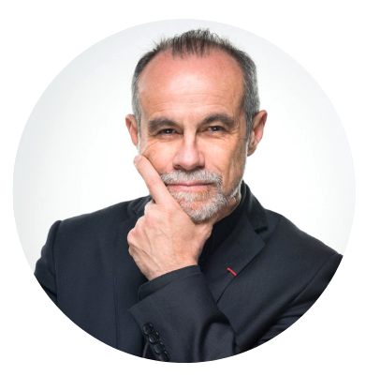
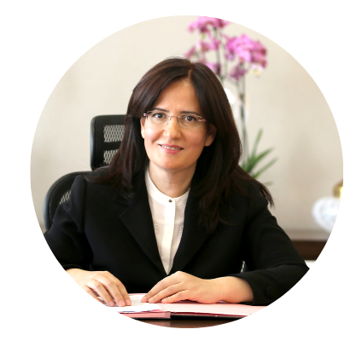
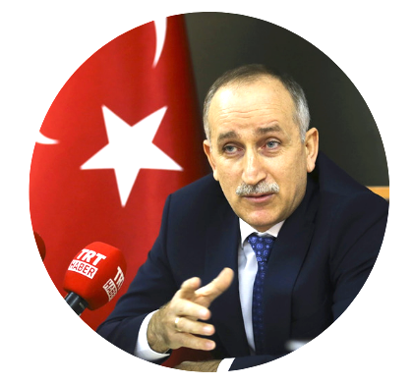
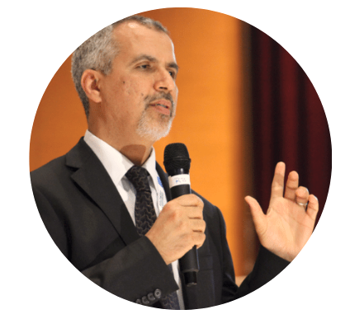
Roundtable 4
Urban Regeneration: Social Value Creation
Speakers
Hon. Ms. Fatma Varank
Deputy Minister for the Ministry of Environment,
Urbanisation and Climate Change
Türkiye
Mr. Ömer Bulut
Mass Housing Development Administration (TOKI)
Türkiye
Mr. Abdelouahed Fikrat, Founder and manager of the Integral Advice Sarl company, Morocco
Prof Carlos Moreno
15 Minute City Global Initiative
Paris I Sorbonne
Moderator: Mr. Javier Torner, Expert, Urban Regeneration, UN-Habitat

Slide 6
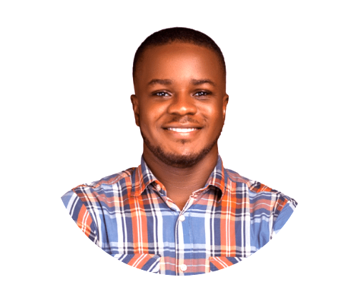
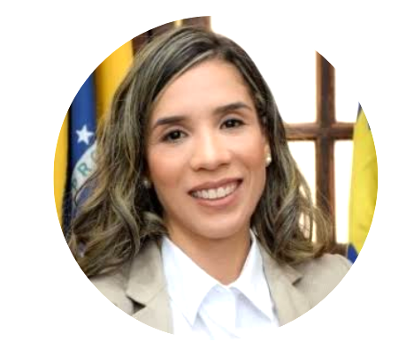
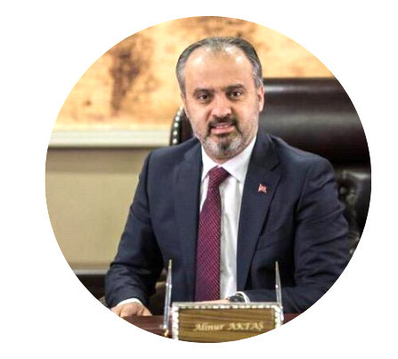
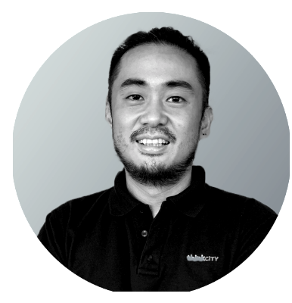
Roundtable 4
Urban Regeneration: Social Value Creation
Speakers
Mr. Stanley Anigbogu
CEO and founder of Artechubs Nigeria
Ms. Marilia Dantas
Secretary of Infrastructure
City Hall of Recife, Brazil
Mr. Alinur Aktaş
Mayor of Bursa
Türkiye
Mr. Lim Jian YI Think City
Malaysia
Moderator: Mr. Javier Torner, Expert, Urban Regeneration, UN-Habitat

Slide 7
Roundtable 4
Urban Regeneration for Social Value Creation
Hon. Ms. Fatma Varank
Deputy Minister for the Ministry of Environment,
Urbanisation and Climate Change
Türkiye

Slide 8
Roundtable 4
Urban Regeneration for Social Value Creation
Mr. Ömer Bulut
Mass Housing Development Administration (TOKI)
Türkiye

Slide 9
Roundtable 4
Urban Regeneration for Social Value Creation
Mr. Abdelouahed Fikrat, Founder and manager of the Integral Advice Sarl company, Morocco

Slide 10
Roundtable 4
Urban Regeneration for Social Value Creation
Prof Carlos Moreno
15 Minute City Global Initiative
Paris I Sorbonne

Slide 11
Roundtable 4
Urban Regeneration for Social Value Creation
Mr. Stanley Anigbogu
CEO and founder of Artechubs Nigeria

Slide 12
Roundtable 4
Urban Regeneration for Social Value Creation
Ms. Marilia Dantas
Secretary of Infrastructure
City Hall of Recife, Brazil

Slide 13
Roundtable 4
Urban Regeneration for Social Value Creation
Mr. Alinur Aktaş
Mayor of Bursa
Türkiye

Slide 14
Roundtable 4
Urban Regeneration for Social Value Creation
Mr. Lim Jian YI Think City
Malaysia

